Slide 1


Initial Product proposal Group 4 – The Quad-Morants

Slide 2
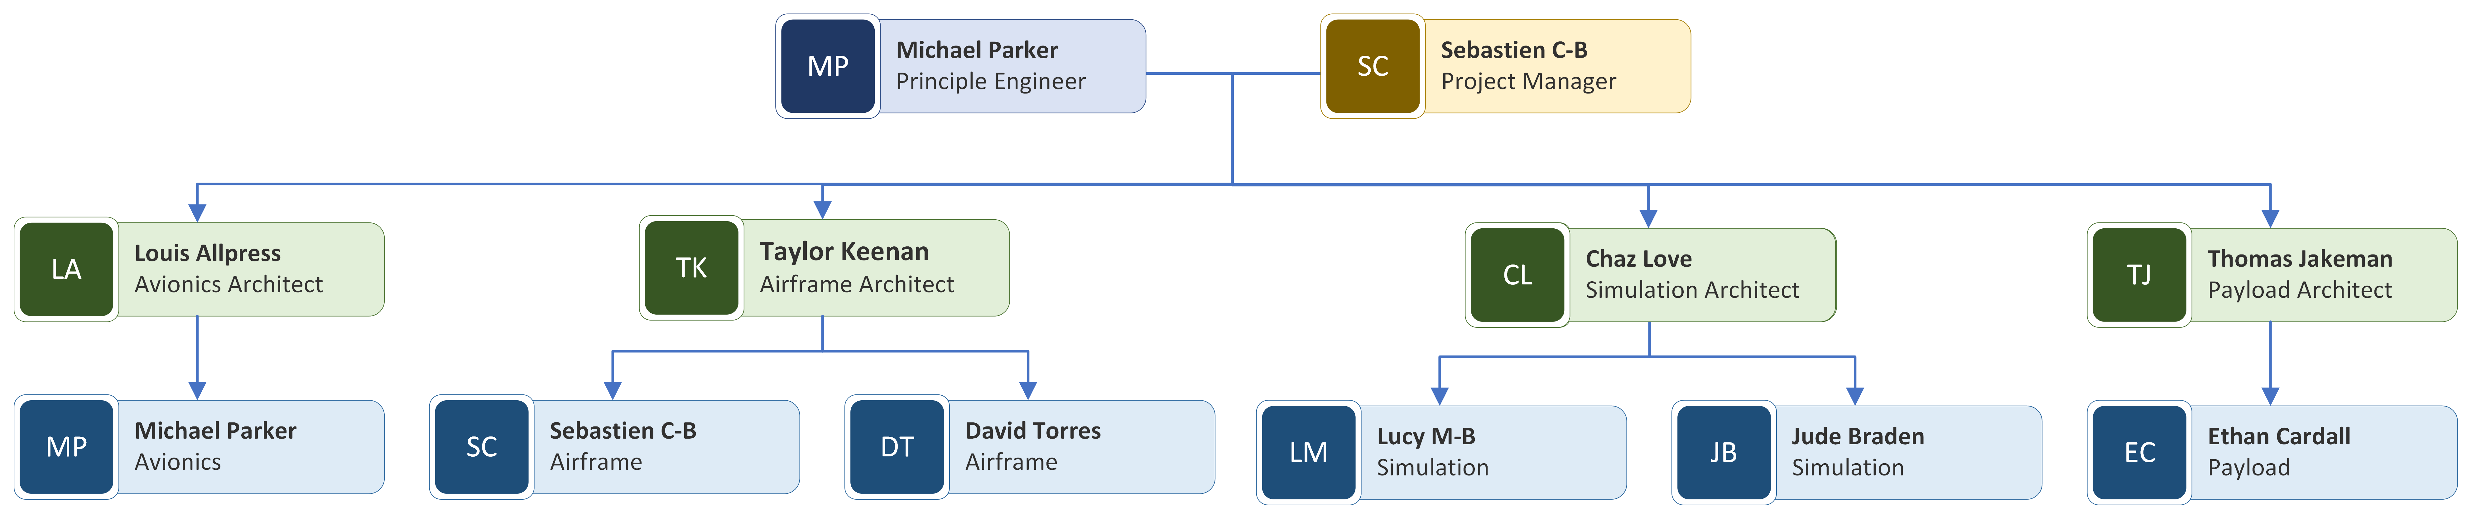

Team Structure

Slide 3
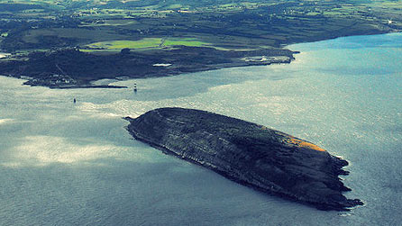

Problem Statement
What is the problem? - Dr Green, from the School of Environmental Sciences at UOL, would like to obtain data regarding the population of Cormorant nests on Puffin Island, located just off the coast of Anglesey.
The aim of gathering this data is to answer three questions:
How many cormorant nests are there on Puffin Island in the summer breeding season?
Where are the cormorant nests on Puffin Island?
How does the number of cormorant nests on Puffin Island change during the summer?
How will this be achieved? - A UAV is required which can take pictures with a ground sampling of 0.82 pixel/cm at a distance of 30m. The vehicle must be waterproof and easy to fly

Slide 4
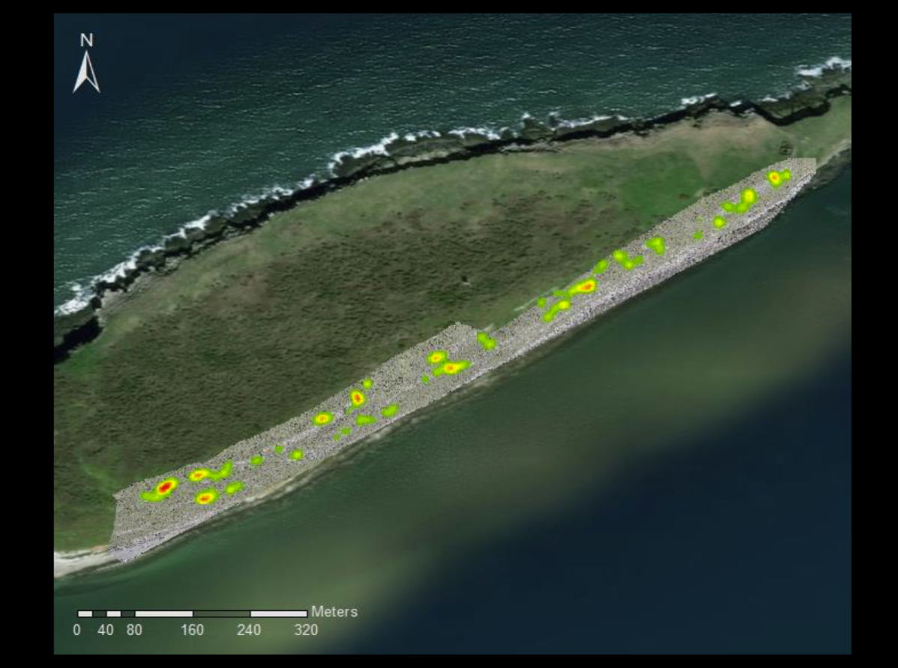
Previous Work
First Attempt with BBC (2018):
Used a DJI Inspire 1 with a 15mm lens
30m altitude
830 images with around a %70 overlap
GSD of 0.43in/pixel
Not a bad attempt but problematic:
Poor planning
Missing areas
Inconsistent image quality
Other work in the field:
The Nature Conservancy team of Colorado used drones to map and analyze Cottonwood trees in fire affected areas
A UAV was used to monitor crocodiles in Nepal, flying 46km at an altitude of 80m along the Babai River

Slide 5
Key customer Requirements
ID | Requirement
CR.1 | The product SHALL be able to capture images of the nesting locations
CR.2 | The product WILL be able to capture video recording
CR.3 | The product SHALL have a camera angle that accounts for the aspect of the site
CR.4 | The products camera SHOULD have a GSD of ~0.82cm/pixel
CR.5 | The product SHALL be collapsible/ packable
CR.6 | The product SHALL be water resistant
CR.7 | The product SHOULD come with free software
CR.8 | The development and final product SHALL not exceed the budget of £800

Slide 6
Quadcopter v Fixed-Wing
 | Advantages | Disadvantages
Quadcopter | Easier to control More stable for recon (clearer photos) More compact for transportation Easier for gimble attachment | Susceptible to wind disturbances Requires more power Shorter flight periods
Fixed Wing | Greater endurance and speed Longer flight times Quieter Higher payload | Needs take-off distance More expensive Harder to land
We opted for a quadcopter design as the advantages of this are more suited to our requirements.
Notes:
Talk specifics about what pros/cons are more important to our requirements (controllability, gimble attachment, compact)

Slide 7
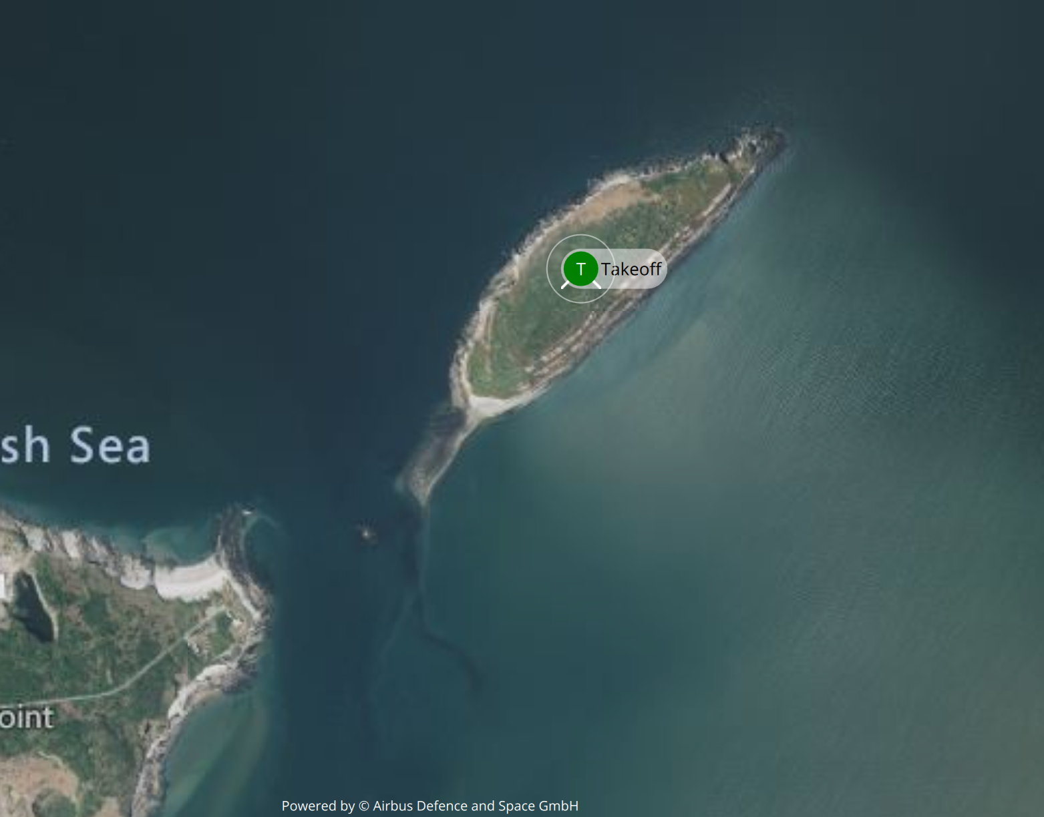

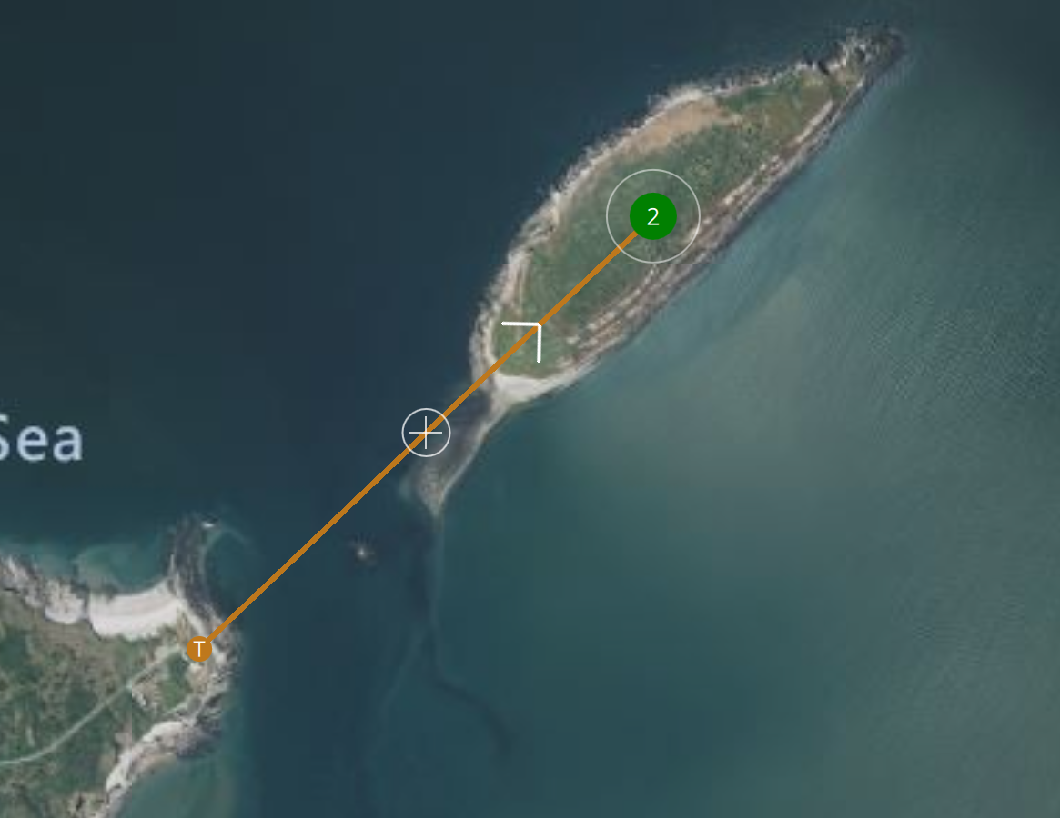


Take-Off Location
Take-Off Location 1​
Puffin Island​
Take-Off Location 1
Puffin Island
Location 1: Puffin Island
Benefits:
Increased flight Range
Centralised take-off location
Less restricted operating requirements (visual line of sight)
Reduced risk of incidents whilst operating drone
Concerns:
Makes operations more complex
Increased risk to persons and wildlife
Location 2: Anglesey
Benefits:
Less complex operations
Reduced risk to persons and wildlife
Take-Off Location 2​
Anglesey
Concerns:
More restrictive operating requirements
(loss of visual line of sight)
Increased risk whilst operating drone over water/ wind resistance
Additional flight range needed to complete same level of coverage compared to puffin island launch.
Distance from launch to middle of island ~1.3KM

Slide 8


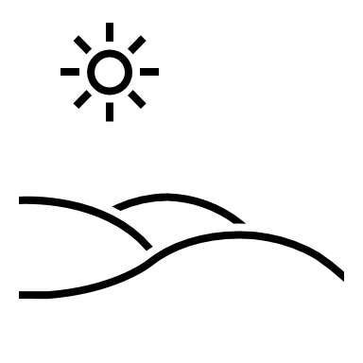

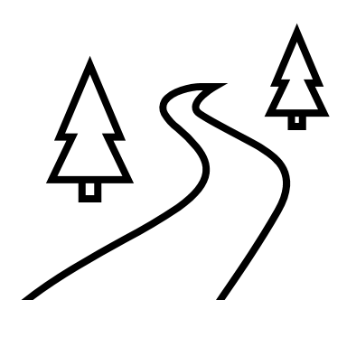
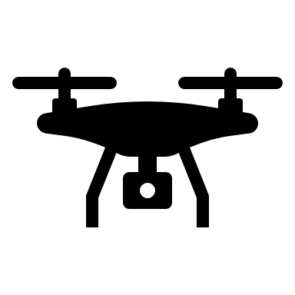







Concept of Operations – Puffin Island Launch

Slide 9
Avionics
Control
Flight Controller: Pixhawk 4 with Autopilot and GPS Module
RF Transmission: Frsky Receiver, 433MHz Telemetry Radio Kit (2 Radio Modules and 2 Aerials)
Software
ArduPilot
QGround Control
OpenDrone Map
Powerplant
Propulsion: T-Motor MN3508 KV700, fitted with 12x4 polymer propeller blades, producing a manufacturer stated 1360g of thrust each.
Speed Controller: Turnigy MultiStar 30A ESC 2~4s
Power Distribution Board: Holybro PM07 5V 3A output 15V input
Battery: Spektrum 5000mAH 30C Battery
Notes:
Mention Thrust testing
And components are subject to change based on delivery and availability requirements
Mention changes duer to thrust teasting

Slide 10
Airframe
Main Requirements:
Lightweight.
Simple and compact.
Airframe must withstand loads without failure.
Provide capacity for mission equipment such as payload and avionics.
Water Resistant.
In early design stages, we must determine:
The required flight envelope for mission.
The load-bearing capacities of each component.
A plan to minimize vibrations to maintain image quality.
Consider environmental conditions for mission.
Airframe Concept:
Water-tight Hub connecting motor arms and housing core electronics and payload.
Hub must be light, and weight evenly distributed for stability.
Motor arms hold the DC motors and propellers which generate lift.
Arms must be strong and durable.
Landing rails provide positioning and clearance for camera.
Landing rails must absorb landing impact.
 | Requirement ID | Description
 | LR.3 | The maximum take-off mass MUST be less than 25kg.
 | CR.3 | The product SHALL have a camera angle that accounts for the aspect of the site.
 | CR.5 | The product SHALL be collapsible/packable.
 | CR.6 | The product SHALL be water resistant.
 | DR.1 | The motor arms SHALL withstand bending moments by a factor of safety of 1.5x the ultimate tensile strength.

Slide 11
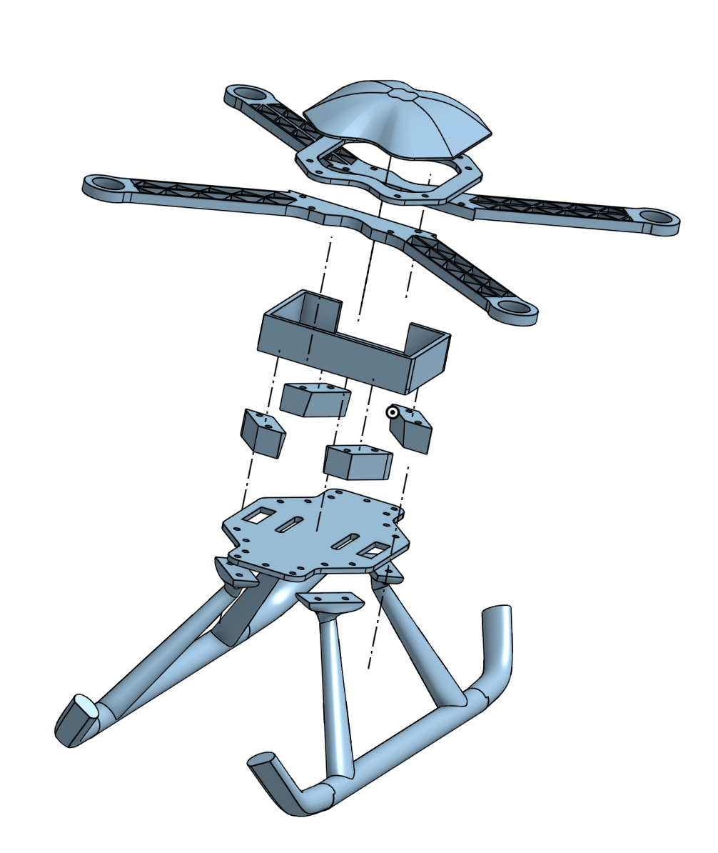
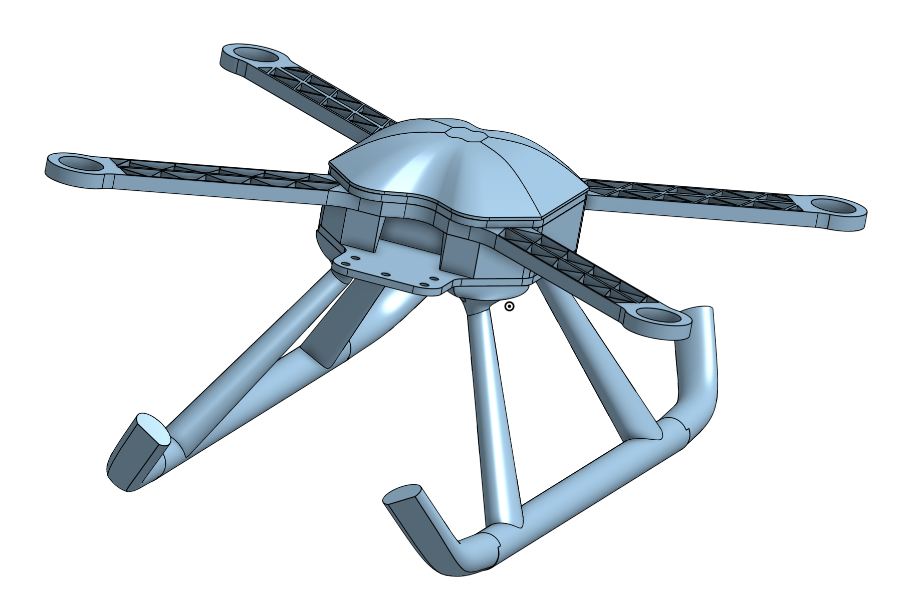
Airframe Conceptual Design
Notes:
This is the current design of the Quad-Morant, modelled in collaboration using OnShape. You can see on the exploded view on the right how we plan to assemble the airframe.

Slide 12
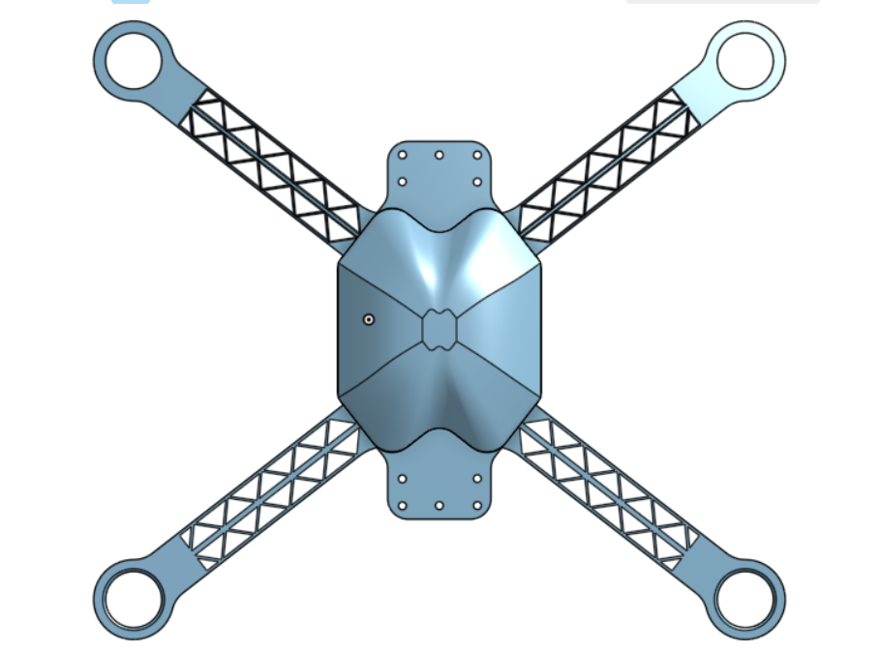
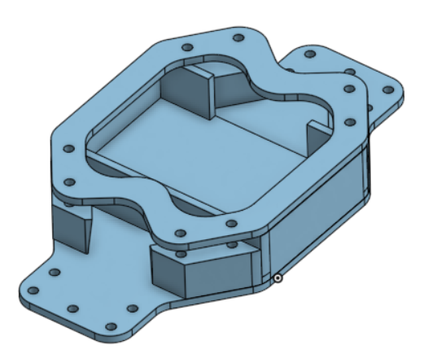
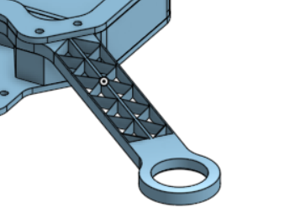
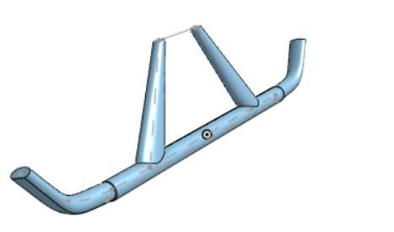
Airframe Design
We must evaluate several components and their function, the materials and the rationale for their use, the manufacturing method for each component and a detailed plan of the building process.
The Hub
Consisting of two robust carbon fibre plates & acrylic box to accommodate the avionics internally.
External mounting point to attach the gimbal underneath the drone.
Hub must withstand torsional and bending loads from motor arms.
3D printed dome to seal internal payload.
Motor Arm
Carbon fibre truss configuration allowing reduced weight without compromising structural integrity.
Motor produces bending moments and motor arm must resist bending loads.
Prevent exposure of wiring to water.
Current model doesn’t include foldable arms, in process of adding a horizontal hinge to make the Quad-morant portable.
Landing legs
Experience mainly axial loads from landing impulse.
Rail configuration which distributes landing impact over larger area and reducing risk of tipping.

Slide 13
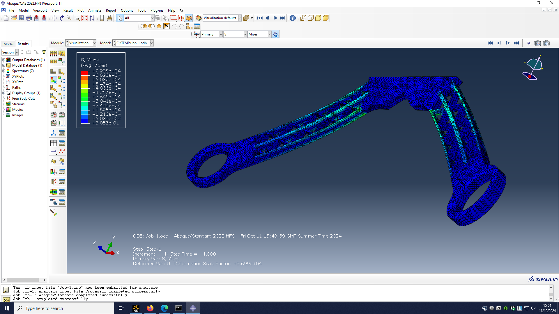
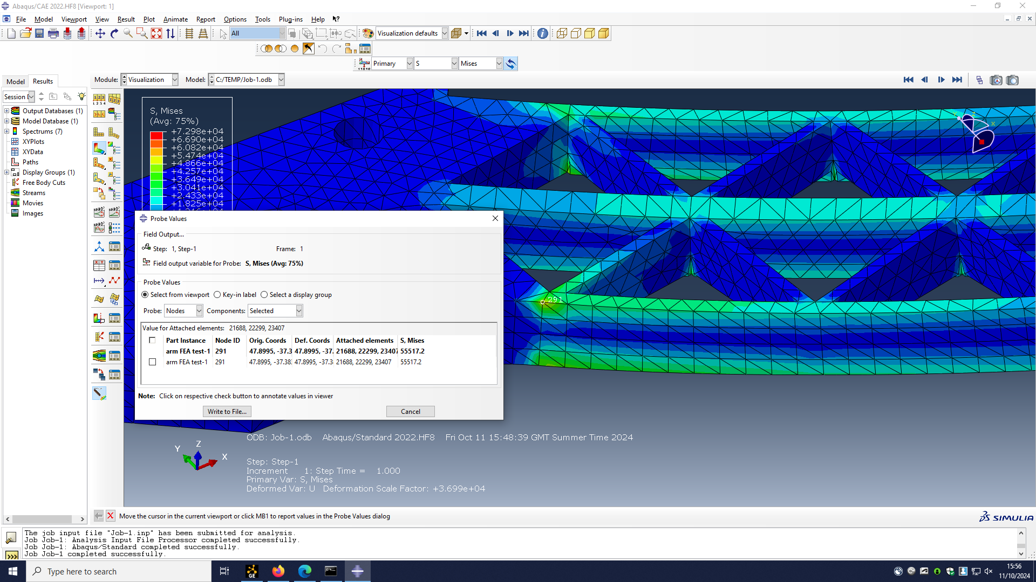
Test Finite Element Analysis
We have liaised with a member of the workshop team to enquire about manufacturing techniques. The Arms can be manufactured several ways. Whether its water jet cut or milled (if its aluminium)
Material | Mass Dens [kg/m3] | Youngs Modulus [MPa] | Poissons ratio
PVC | 1300-1450 | 2.4-4.1 | 0.4
CFRP | 1600 | 69-150 | 0.15
Aluminium 6061 | 2500-2900 | 68-82 | 0.334
Stainless steel | 7600-8100 | 190-210 | 0.27-0.31
For this test, the chosen material was aluminium 6061. For preliminary testing in future. The Elastic limit and yield limit of the material is needed to measure the loading required to plastically deform and break the arms.

Slide 14
Initial Weight Estimation
For the initial weight estimation it was taking into account different quadcopter masses from similar type of mission to have an idea of the challenges that could be affecting our project in terms of weight.
The weights of similar quadcopters were in a range from 0.7 kilos up to more than 20 kilos depending on different devices and sizes that compose:
-Airframe
-Avionics
-Payload
For the project, the requirements needed to be met for the Initial Weight Estimation are:
Requirement ID | Description
LR.3 | The maximum take-off mass MUST be less than 20kg
Notes:
For the Initial Weight Estimation, Quadmorants have been checking for examples in the market of different types of quadcopters that perform drone photography to know the range in weight in which this type of drones operate. It has been notice that the weight range of the drones is huge and it goes from really lightweight ones to heavy drones that sometimes goes even beyond the requirements, rejecting them from the possible competitors that could suit the mission of the project. These requirements are LR.3 from the Legal requirements of the VCRM which states that the maximum take off mass must be less that 20 kg and a design requirement in which the thrust to weight ratio should be 2:1 to allow the drone to hover with half throttle.

Slide 15
Initial Weight Estimation
In the case of Quad Morants, the initial weight takes into consideration the research of the different essential parts carried out by each team (Airframe, Avionics and Payload) to develop an estimation:
 | Parts | Weight (g)
Avionics | Brain (Pixhawk 4/ w gps) | 50
 | Power distribution board (PM07) | 36
 | Motor brushless (x4) (T-Motor MN 3508 KV 700) | 400
 | Motor blades (x4) (T-Motor 12inch) | 60
 | ESC (x4) (30A) | 120
 | Receiver (FRsky) | 15
Payload | Camera (Sony Alpha a5000) | 269
 | Gimble | 350
Battery |  | 700
Empty | Airframe | 1553.55
Total Weight |  | 3553.55
Weight estimation of the different components of the quadcopter
Notes:
In the case of the quadcopter we are designing, the different groups of the project, which are Avionics, Payload, Simulation and Airframe do a research of the different items that are part of their sub-assembly. As it can be seen on the table below, this are the weights of the different components from the quadcopter, leaving our drone with an Initial Weight Estimation of 3 and a half kilos approximately.

Slide 16
Simulation
Why use simulation?
Cost and time effectiveness
Accurate numerical results
Sustainability
MATLAB | SIMULINK
Estimates of thrust and power required from the initial mass | Allows simulation of the 4 rotors rather than the 1 from momentum theory
To analyse data outputted from Simulink in a timely and neat manner | Allows rotors to be accurately tuned (PID controllers)
 | Stability can be modelled and tested (add wind disturbances into simulation)
Notes:
Simulation will be used throughout this whole project. For this section I will be starting with the advantages of using Simulation:
Using simulation is much cheaper than conducting lots of practical tests and much less time consuming, both of which are restrictors for us in this project
Gaining numerical results allows better decision making during the design process such as the required size of the propellor blades in order to produce enough thrust
Sustainability also plays a big role in today's world of engineering. Using simulation allows less materials to be used during testing, for example this could be the use of components such as non-recyclable batteries being used in physical testing however using simulation avoids that entirely.
The tools that will be used for simulation will be both MATLAB and Simulink:
- MATLAB has already been used utilising rotorcraft momentum theory to estimate the thrust produced by the 4 rotors of the quadcopter which will be presented on the next slide. MATLAB can also be used in conjunction with Simulink to analyse the data outputs that the Simulink model provides.
Simulink will allow the 4 rotors to be modelled separately with better fidelity than that of the results of the initial momentum theory calculations. PID controllers can also be implemented and easily tuned in Simulink for precise control of the individual motors during flight to prevent the quadcopter from becoming unstable and potentially crashing. Furthermore, the stability of the aircraft can be further tested by implementing external forces such as wind into the model to see what the limits of the quadcopter are.

Slide 17
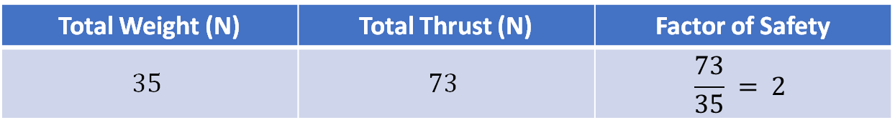
Initial Momentum Theory
T
Total Weight (N) | Total Thrust (N) | Factor of Safety
$$35$$ | $$73$$ | $$\frac{73}{35} = 2$$
R
W
Assumptions:
Figure of Merit = 0.6
ISA Sea Level Density = 1.225 kg/m³
Notes:
Using momentum theory, the thrust of the quadcopter has been calculated based off the components the avionics team have currently opted for. Through a few simple steps, the thrust was calculated to be 73N. In comparison to the quadcopters weight, it has a factor of safety of approximately 2 leaving us with a large margin before the UAV would theoretically be unable to take-off due to the weight overpowering the thrust produced.
There are two main assumptions in this momentum theory analysis. The first being the figure of merit of the system, this is essentially the efficiency of the rotors. At this stage, the efficiency has been taken as 60%.
The next assumption is the air density. Due to the aircraft flying at a minimum of 30m and maximum of 120m as stated by the requirements, the air density has been taken as standard ISA at sea level, as this distance above sea level is not enough for the air density to have any real effect on the rotor's efficiencies.
Due to these assumptions, this factor of safety is only an estimate however it is a good starting point.

Slide 18
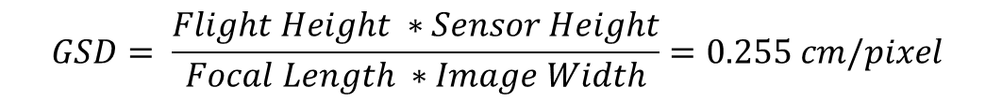
Payload - Camera
Sony α5000 SELP 1650 Lens Specification
Resources Provided
Sony α5000 and SELP 1650 Lens
Battery and Media
Requirements
70% image overlap
Resolution: Suggested approximately 0.82cm/pixel
Recording Height of 30 meters
Part | Specification
Sensor Size | 23.2 x 15.4 mm
Number of effective pixels | 20.1 MP
Number of total pixels | 20.4 MP
Approximate Image Resolution | 5456 x 3632
Focal Length | 50 mm
Size | 109.6 x 62.8 x 35.7 mm
Total Weight | 385 g
Battery Life | 420 Shots or 150-minute continuous recording (Approximate)
Ground Sampling Distance (GSD):
Dependent Values:
Flight Height – 30m
Sensor Width – 23.2mm
Focal Length – 50 mm
Image width – 5456 pixels
$$GSD= \frac{Flight Height ∗Sensor Height}{Focal Length ∗Image Width}=0.255 cm/pixel$$

Slide 19
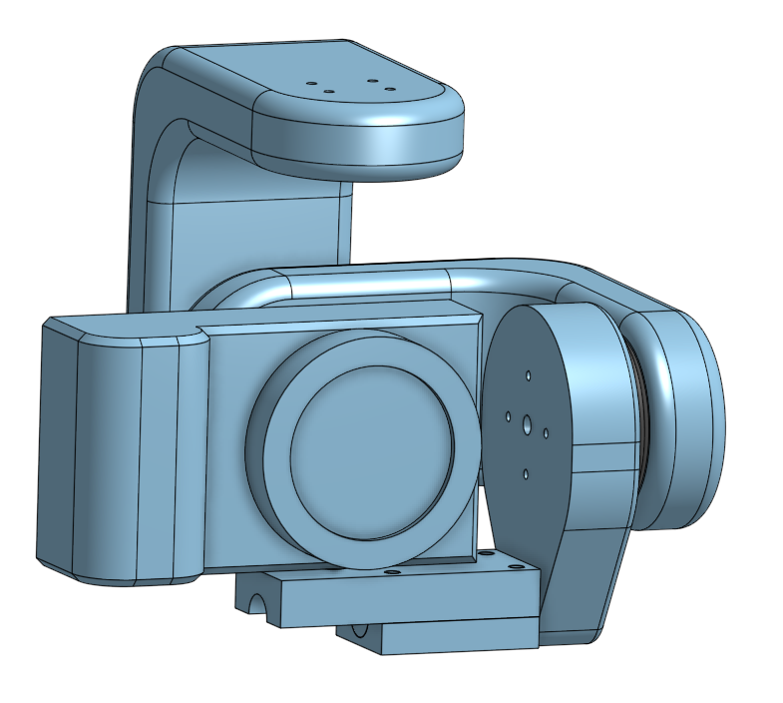
Payload - Gimbal
Type | Advantages | Disadvantages
No Gimbal | Reduces costs significantly | Fixed camera position Unstable camera during flight
2 Axis | Light Not as expensive as 3 axis Stable photos when in forward flight | Unstable footage when drone is moving from left to right (no yaw axis for camera)
3 Axis | Most stable option for camera to obtain footage | Expensive Heaviest option
Based on the table, we have opted for the 2 Axis gimbal as it minimizes weight and costs, while still providing the ability for stable footage/ images in the pitch and roll axis.

Slide 20
Verification Cross Reference Matrix
ID | Requirement Description | Responsibility | Verification Method |  |  |  |  |  | Success Criteria
 |  |  | I | R | S | D | PT | FT
Legal Requirements
LR.1 | The product MUST not fly beneath 30m minimum altitude from puffin island | Simulation, Avionics | x |  |  |  |  |  | Fences have been setup for the products flight plan to stop the drone from flying outside these bounds.
LR.2 | The product MUST not fly above 120m from the closest point to the earths surface (note: this is not just including vertical height) | Simulation, Avionics | x |  |  |  |  |  | Fences have been setup for the products flight plan to stop the drone from flying outside these bounds.
LR.3 | The maximum take-off mass MUST be less than 20kg | Airframe | x |  |  |  |  |  | An inspection will be made prior to flight to make sure weight limits haven’t been exceeded
LR.4 | Pilot flying MUST maintain Visual line of sight during operation |  |  |  |  |  |  | x | Ensure there's a professional flying the product at all times
LR.5 | The product MUST not drop any material during flight | ALL | x |  |  |  |  |  | No mechanism included in the design that will allow that to happen
Customer Requirements
CR.1 | The product SHALL be able to capture images nesting locations | Payload, Simulation |  |  |  | x |  | x | Demonstration will show remote activation of the camera shutter, The file will be saved to a microsd card.
CR.2 | The product WILL be able to capture video recording | Payload |  |  |  | x |  |  | Demonstration will show remote activation of the recording, The file will be saved to a microsd card.
CR.3 | The product SHALL have a camera angle that accounts for the aspect of the site | Payload, Airframe |  | x |  | x |  |  | The review and the demonstration will show a clear aspect with no obstructions to the view
CR.4 | The products camera SHOULD have a GSD of ~0.82cm/pixel | Payload |  |  | x |  |  | x | Pixels will be counted on a test target at 30 meters away using the camera to see if the resolution will meet 0.82cm/pixel .
CR.5 | The product SHALL be collapsible/ packable | Airframe |  |  |  |  |  |  | The drone will be have collapsing arms and fit in the boot of a typical sudan
CR.6 | The product SHALL be water resistant | Airframe |  |  |  |  | x |  | Water submergence test will be carried out with the structure without the avionics inside. A dummy payload will be inside to test saturation.
CR.7 | The product SHOULD come with free software | Avionics |  |  |  | x |  |  | A demonstration will display the free software in use
CR.8 | The development and final product SHALL not exceed the budget of £800 | ALL | x |  |  |  |  |  | A Budget breakdown and analysis will pass gate review phases across project completion. Along with a final inspection before FTRR
Design Requirements
DR.1 | Motor arms SHALL withstand bending moments by a factor of safety of 1.5x the Ultimate tensile strength | Airframe |  |  | x |  | x |  | Motor arm deflection test will validate finite element test results on von mises criteria.

Slide 21
Initial Work Breakdown structure
ID | type | At Risk? | Description | Assigned to | Duration | Week | Status | Sign Off
1 | Milestone | No | Conceptual Design | All | 28 Days |  | In Progress
1.1 | Task | No | Backround research | All | 1 Day | S1, Week 1 | In Progress
1.2 | Task | No | Team Role Selection | All | 1 Day | S1, Week 1 | Complete | Michael Parker
1.3 | Task | No | Requirements Breakdown | All | 3 Days | S1, Week 2 | Complete | Michael Parker
1.4 | Task | No | Platform Selection | All | 1 Day | S1, Week 2 | Complete | Michael Parker
1.5 | Task | Yes | Avionic selection | Louis Allpress | 5 Days | S1, Week 2 | Complete | Michael Parker
1.6 | Task | No | Airframe CAD Concept formulation | Taylor Keenan | 9 Days | S1, Week 3 | Complete | Michael Parker
1.7 | Task | No | Gimbal CAD Conceptual Design Formulation | Thomas Jakeman | 9 Days | S1, Week 3 | Complete | Michael Parker
1.8 | Task | No | Materials research | Sebastien C-B | 2 Days | S1, Week 3 | Complete | Michael Parker
1.9 | Task | No | Material Selection | Taylor Keenan | <1 Day | S1, Week 3 | Complete | Michael Parker
1.1 | Task | No | Initial Finite element Analysis | Sebastien C-B | 2 Days | S1, Week 3 | Complete | Michael Parker
1.11 | Task | No | Initial Momentum Theory | Chaz Love | 4 Days | S1, Week 3 | Complete | Michael Parker
1.12 | Task | Yes | Budget set | Michael Parker | 1 Day | S1, Week 3 | Complete | Michael Parker
1.13 | Task | No | IPP Presentation | All | 12 Days | S1, Week 4 | incomplete
1.14 | Milestone | No | IPP Gate Review | All | NA | S1, Week 4 | incomplete
1.15 | Task | No | IPP Report | All | 7 Days | S1, Week 5 | incomplete
2 | Milestone | No | Preliminary Design | All | 22 Days |  | incomplete
2.1 | Task | Yes | First Propellar Thrust Test | Louis Allpress | <1 Day | S1, Week 4 | incomplete
2.2 | Task | Yes | Part order form sent out | Sebastien C-B | 1 Day | S1, Week 6 | incomplete
2.3 | Task | Yes | Motor Arm Deflection Test | Taylor Keenan | <1 Day | S1, Week 9 | incomplete
3 | Milestone | No | Detail Design | All | 27 Days |  | incomplete
3.1 | Task | No | Sony a5000 camera Inspection | Michael Parker | <1 Day | S1, Week 10 | incomplete
3.2 | Task | No | FDR Presentation | All | 35 Days | S1, Week 11 | incomplete
3.3 | Milestone | No | FDR Gate Review | All | NA | S1, Week 11 | incomplete
3.4 | Task | No | FDR Report | All | 7 Days | S1, Week 12 | incomplete
4 | Milestone | Yes | Production | All | 56 Days |  | incomplete
4.1 | Task | Yes | PID Control Tune Test | Louis Allpress | <1 Day | S2, Week 3 | incomplete
4.2 | Task | No | Ardupilot flight plan inspection | Michael Parker | <1 Day | S2, Week 6 | incomplete
4.3 | Task | Yes | Platform GSD Test | Thomas Jakeman | 2 Days | S2, Week 7 | incomplete
4.4 | Task | No | Final Spending Inspection | Sebastien C-B | <1 Day | S2, Week 8 | incomplete
4.5 | Task | No | Final Platform Weight Inspection | Michael Parker | <1 Day | S2, Week 8 | incomplete
4.6 | Task | No | FTRR Presentation | All | 63 Days | S2, Week 9 | incomplete
4.7 | Milestone | No | FTRR Gate Review | All | NA | S2, Week 10 | incomplete
4.8 | Task | No | FTRR Report | All | 7 Days | S2, Week 11 | incomplete
4.9 | Task | Yes | Camera Angle and control Demonstration | Thomas Jakeman | 1 Day | S2, Week 11 | incomplete
5 | Milestone | Yes | Flight Test Evaluation | All | NA | S2, Week 12 | incomplete

Slide 22
Budget
Total Budget With University discount
Total Budget
Component | Quantity | Cost (£)
Pixhawk 4 & Power Management Module & GPS | 1 | 151.00
FRSky S8R Receiver | 1 | 30.95
30A ESC | 4 | 65.00
T-Motor 12x4 Blades | 2 | 65.00
Sony A5100 w/16-50mm Lens | 1 | 399.99
5000mAH Battery 30C | 1 | 50.00
airframe | 1 | 100 (estimate)
3D Printed Gimbal and 2 Motors | 1 | £100 (Estimate)
Total Cost |  | £861.94
Component | Quantity | Cost (£)
Pixhawk 4 & Power Management Module & GPS | 1 | 37.75
FRSky S8R Receiver | 1 | 30.95
30A ESC | 4 | 65.00
T-Motor 12x4 Blades | 2 | 65.00
Sony A5100 w/16-50mm Lens | 1 | 399.99
5000mAH Battery 30C | 1 | 50.00
airframe | 1 | 100 (estimate)
3D Printed Gimbal and 2 Motors | 1 | £100 (Estimate)
Total Cost |  | £317.75
Notes:
Mention the crossed out items are given to us

Slide 23
Mitigating Risks
ID | Date raised | Risk Description | Probability | Impact | Severity | Mitigation | Contingency plan | Signed off by
1.1 | 11/10/2024 | Illness of team member | 7 | 3 | 21 | following the WHO guidelines | Redistribute workloads across the whole team to fill in for an ill team mate | Michael Parker
1.2 | 11/10/2024 | Team member Injury | 1 | 4 | 4 | Team members to take care during physical activity | Redistribute the workloads of the affected member | Michael Parker
1.3 | 11/10/2024 | Mentor weekly inavailability | 6 | 2 | 12 | Before scheduled meeting, ensure staff availabilty | arrange for alternate schedule for the affected weeks. | Michael Parker
1.4 | 11/10/2024 | Team member timetable clash | 2 | 3 | 6 | Regularly check calenders | Fill out a progree report for that week and all others | Michael Parker
1.5 | 11/10/2024 | Part Manufacturing error | 6 | 8 | 48 | Order the Parts early. | Reorder the parts or think of alternative solutions to the problem. | Michael Parker
1.6 | 11/10/2024 | Project files save Corruption/overwrite | 4 | 10 | 40 | Have muliple backups of main repository | GitHub has a feature to recover deleted files. | Michael Parker
1.7 | 12/10/2024 | HHTC room availability | 6 | 6 | 36 | leave plenty of University working days to complete the tasks | Use Abaqus Student edition and to a limited 1D beam analysis instead. | Michael Parker
1.8 | 12/10/2024 | 3D Printing Availability | 8 | 4 | 32 | Get required 3D printing CAD drawings completed early | Syndey Jones and Harold Cohen On-Campus Libraries offer alternative 3D printers. | Michael Parker
1.9 | 12/10/2024 | Lipo battery explodes | 5 | 10 | 50 | Discharge the Battery to resting charge, place in sandbag | Arrange for a back up Lipo for the TFE . | Michael Parker

Slide 24
Thank You for listening!

